Slide 1
Website Design and Development
Abdul Rehman Ashraf
Full Stack Web Developer

Slide 2
Full Stack Web Developer
A full-stack developer is a programmer who works within software development and is knowledgeable in both the front end and back end of an application. They work to create a seamless user experience through their diverse skill set. They're also well-versed in databases, server configuration and user interface.

Slide 3
Full Stack Web Developer
It's important to note that as a full-stack developer, you're not required to know everything, but having an overall understanding of what's going on in the front end and back end is key.

Slide 4
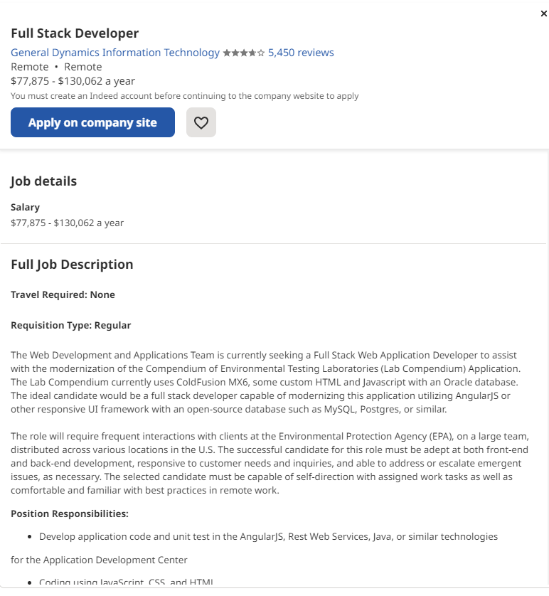
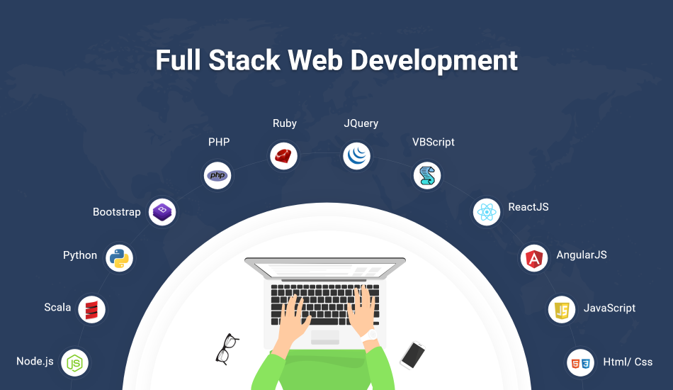
Market Demand

Slide 5
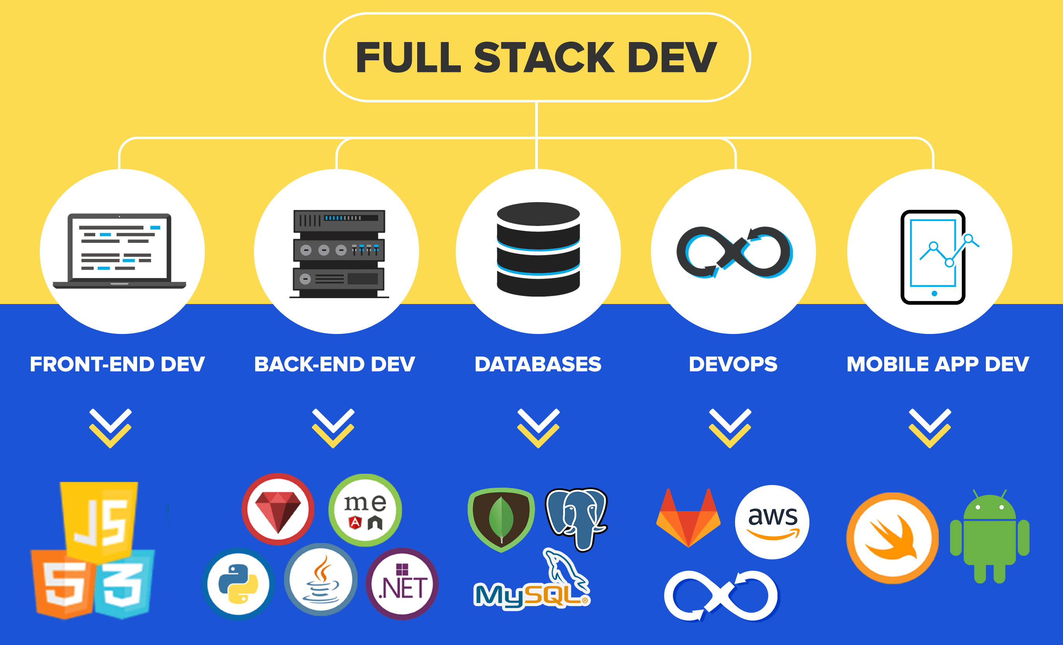

Slide 6
Front End Development
The part of a website like text colors and styles, images, graphs and tables, buttons, colors, and navigation menu. The structure, design, behavior, and content of everything seen on browser screens when websites, web applications, or mobile apps are opened up, is implemented by front End developers.
User Interfaces
Client Side
Users Experience
Responsiveness
Performance
The developer must ensure that the site is responsive i.e. it appears correctly on devices of all sizes no part of the website should behave abnormally irrespective of the size of the screen.

Slide 7
Front end Languages:
HTML: HTML stands for Hypertext Markup Language. It is used to design the front-end portion of web pages using a markup language. HTML is the combination of Hypertext and Markup language. Hypertext defines the link between the web pages. The markup language is used to define the text documentation within the tag which defines the structure of web pages.
CSS: Cascading Style Sheets fondly referred to as CSS is a simply designed language intended to simplify the process of making web pages presentable. CSS allows you to apply styles to web pages. More importantly, CSS enables you to do this independent of the HTML that makes up each web page.
JavaScript: JavaScript is a famous scripting language used to create magic on the sites to make the site interactive for the user. It is used to enhancing the functionality of a website to running cool games and web-based software.

Slide 8
Front End Frameworks and Libraries:
jQuery: jQuery is an open-source JavaScript library that simplifies the interactions between an HTML/CSS document, or more precisely the Document Object Model (DOM), and JavaScript. Elaborating the terms, jQuery simplifies HTML document traversing and manipulation, browser event handling, DOM animations, Ajax interactions, and cross-browser JavaScript development., some other Frameworks are;
AngularJS
React.js
React.js
SASS
Flutter

Slide 9
Backend Development
Backend is the server-side of the website. It stores and arranges data, and also makes sure everything on the client-side of the website works fine. It is the part of the website that you cannot see and interact with. It is the portion of software that does not come in direct contact with the users. The parts and characteristics developed by backend designers are indirectly accessed by users through a front-end application. Activities, like writing APIs, creating libraries, and working with system components without user interfaces or even systems of scientific programming, are also included in the backend.

Slide 10
Backend Languages
Back end Languages: The back end portion is built by using some languages which are discussed below:
PHP: PHP is a server-side scripting language designed specifically for web development. Since PHP code executed on the server-side, so it is called a server-side scripting language.
C++: It is a general-purpose programming language and widely used nowadays for competitive programming. It is also used as a backend language.
Java: Java is one of the most popular and widely used programming languages and platforms. It is highly scalable. Java components are easily available.
Python: Python is a programming language that lets you work quickly and integrate systems more efficiently.
JavaScript: JavaScript can be used as both (front end and back end) programming languages.
Node.js: Node.js is an open-source and cross-platform runtime environment for executing JavaScript code outside a browser. You need to remember that NodeJS is not a framework, and it’s not a programming language. Most people are confused and understand it’s a framework or a programming language. We often use Node.js for building back-end services like APIs like Web App or Mobile App. It’s used in production by large companies such as Paypal, Uber, Netflix, Wallmart, and so on.

Slide 11
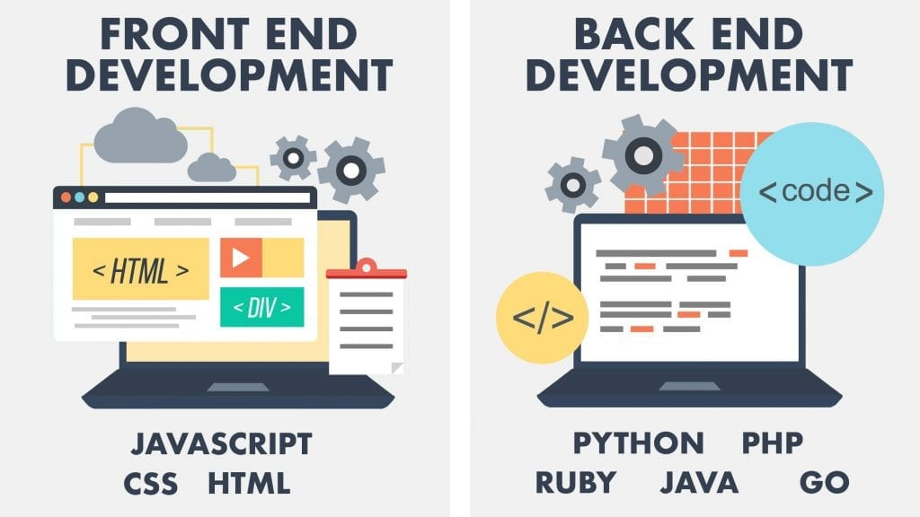

Slide 12
